Slide 1
AN INTEGRATED CLINICAL & GENOMIC
MACHINE LEARNING APPROACH
Predicting 5-Year Survival and Time-to-Event in Breast Cancer
Hellenic Open University
Data Science & Machine Learning (DAMA)
Demiris Stefanos Panagiotis, Diamantis Theodosis, Lantouri Athanasia, Miteloudis Alexandros
Notes:
Breast cancer molecular heterogeneity makes it hard to predict prognosis with clinical data alone.

Slide 2
INTRODUCTION & CHALLENGE
BREAST CANCER HETEROGENEITY
Breast cancer accounts for roughly 30% of all new female cancer diagnoses globally. While doctors have traditionally relied on clinical variables like tumor size and histologic grade to predict patient outcomes, these physical traits fail to capture the deep biological differences hidden inside the tumor.
Our core objective is to determine if we can make more accurate predictions. We want to see if integrating a targeted 22-gene expression panel and genetic mutation data significantly improves our ability to predict 5-year survival compared to using standard hospital data alone.
Notes:
Breast cancer molecular heterogeneity makes it hard to predict prognosis with clinical data alone.

Slide 3
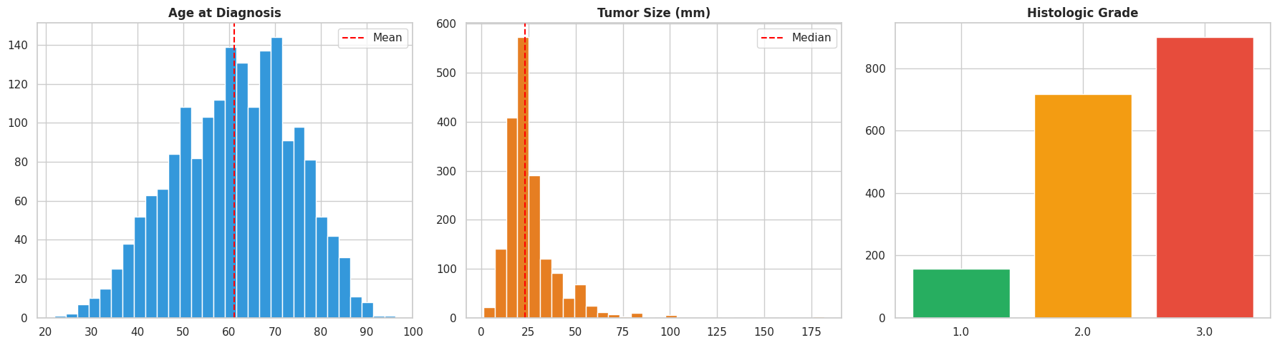
DATASET OVERVIEW
THE EDA PLOTS
To answer this question, we analyzed the METABRIC dataset, tracking 1,904 patients. Before building any AI models, we profiled the cohort to understand the baseline clinical traits, such as the age at diagnosis—which averaged 61 years—and the distribution of tumor sizes and grades.
Notes:
Breast cancer molecular heterogeneity makes it hard to predict prognosis with clinical data alone.

Slide 4
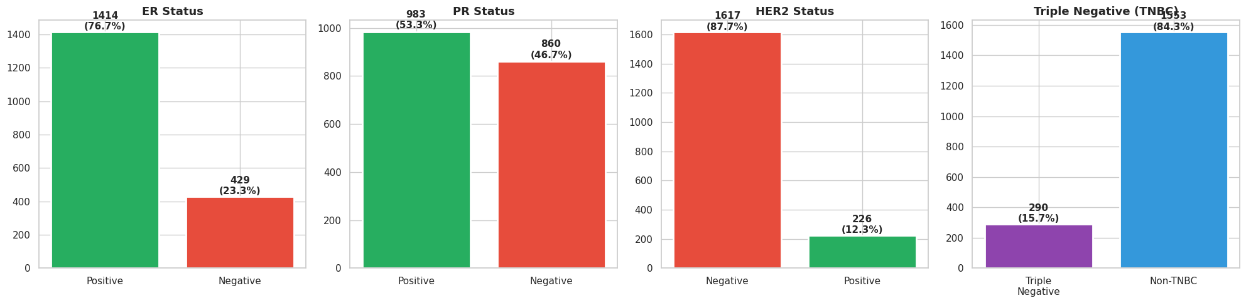
DATASET OVERVIEW
THE EDA PLOTS
We also examined hormone receptor statuses (ER, PR, and HER2). Notably, our data visualisations highlight that approximately 15.6% of the cohort suffers from Triple Negative Breast Cancer, which is widely recognized as the most challenging and aggressive subtype to treat.
Notes:
Breast cancer molecular heterogeneity makes it hard to predict prognosis with clinical data alone.

Slide 5
METHODOLOGY
THE ABLATION STUDY
To prove exactly where our predictive power comes from, we designed an "Ablation Study." First, we carefully filtered out "early-censored" cases to ensure our models were learning from absolute ground-truth data.
We then tested four distinct feature configurations. We started with a "Clinical-only" baseline. Next, we tested the genomic data in isolation by running a "Gene Expression-only" model and a "Mutation-only" model. Finally, we brought everything together into a "Fully Integrated" model to see if combining these modalities provided a measurable advantage.
Notes:
Filtered "early-censored" cases to ensure ground-truth accuracy and binarized mutation statuses.

Slide 6
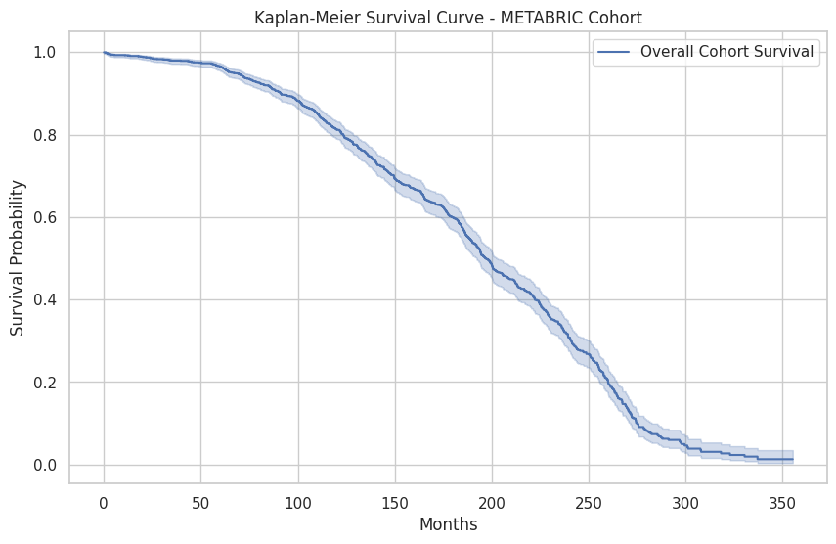
RESULTS | SURVIVAL ANALYSIS
LONG TERM SURVIVAL ANALYSIS
Model: Cox Proportional Hazards
Metric: Concordance Index (C-Index) of 0.6734
We used Cox Proportional Hazards to predict not just if a patient survives, but how long. Our model successfully ranks patient risk over long-term follow-ups, proving its durability beyond a simple 5-year window.
Notes:
We didn't just predict survival at year 5; we modeled the entire patient journey. A C-Index of 0.67 shows strong ranking capability over long-term follow-ups.

Slide 7
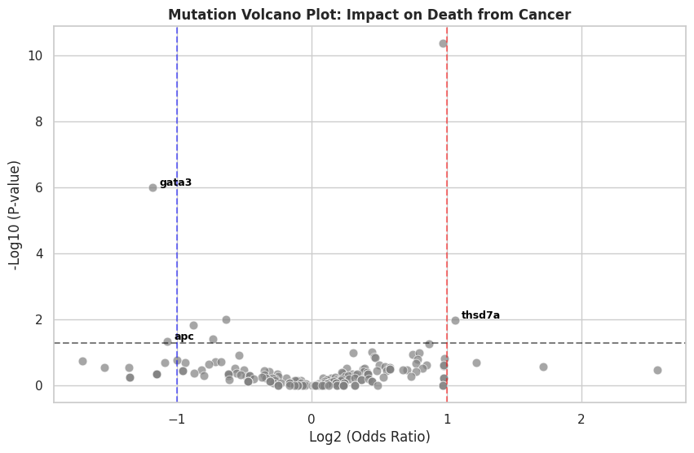
RESULTS | STATISTICAL VALIDATION
IDENTIFYING MOLECULAR DRIVERS
Significant Risk: TP53 mutations
Significant Protection: GATA3 mutations
This volcano plot statistically maps the relationship between specific mutations and patient mortality risk. The model identified the TP53 mutation as the most significant driver of aggressive cancer and mortality. Conversely, it identified GATA3 as a protective factor. This convergence proves our computational findings align with established biological reality.
Notes:
Our model correctly identified TP53 as the top risk factor, which matches global oncology standards, validating our statistical pipeline

Slide 8
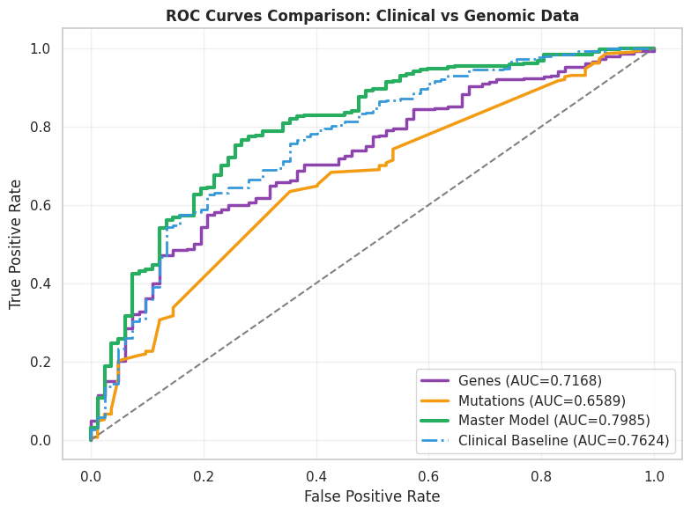
PERFORMANCE GAINS
INTEGRATED MODEL PERFORMANCE (THE AUC COMPARISON)
The value of multi-omic data becomes undeniable. By themselves, genetic mutations were the weakest predictor, simply because they are rare across the general population.
However, when we look at the Fully Integrated model, it achieved an Area Under the Curve (AUC) of 0.7985. This is a solid 4.7% improvement over the standard clinical baseline, proving that combining molecular data with physical tumor traits yields the highest accuracy.
Notes:
Focus on that +4.7% boost. In a clinical setting, that increase represents many patients getting a more accurate prognosis.

Slide 9
DISCUSSION
CLINICAL RELEVANCE
While traditional clinical features remain the dominant signal for predicting survival, they are not the complete picture. Genomic integration provides a critical, measurable "lift" in prognostic accuracy.
By combining clinical, gene expression, and mutation data through a rigorous machine learning pipeline, we provide a transparent framework for the future of oncology. These findings strongly support the integration of multi-modal data to help doctors design truly personalized treatment plans for breast cancer patients.

